Slide 1
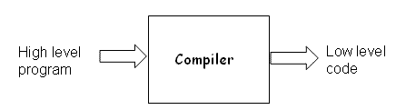
NAME OF THE FACULTY: R.SANDEEP KUMAR
SUBJECT: COMPILER DESIGN (13A05502) YEAR/SEM: III-I
LESSON PLAN:-
Sno Topic Name No.of Classes
Unit-I Introduction
1 Language Processors, Phases of a Compiler 2
2 Pass and Phase,Bootstrapping,Compiler construction Tools 2
3 Applications of compiler technology, Programming language 2 basics
4 Lexical Analysis: Role and Responsibility, Input buffering 2
5 Specification of tokens, Recognition of tokens 2
6 LEX tool, Design of a Lexical Analyzer generator 2
Total No.of classes required for Unit-I 12
What are Compilers?
Compiler is a program which translates a program written in one language (the source language) to an equivalent program in other language (the target language). Usually the source language is a high level language like Java, C, FORTRAN etc. whereas the target language is machine code or "code" that a computer's processor understands. The source language is optimized for humans. It is more user-friendly, to some extent platform-independent. They are easier to read, write, and maintain and hence it is easy to avoid errors. Ultimately, programs written in a high-level language must be translated into machine language by a compiler. The target machine language is efficient for hardware but lacks readability.
➢ Translates from one representation of the program to another
➢ Typically from high level source code to low level machine code or object code
➢ Source code is normally optimized for human readability
➢ Expressive: matches our notion of languages (and application?!)
➢ Redundant to help avoid programming errors
➢ Machine code is optimized for hardware
➢ Redundancy is reduced
➢ Information about the intent is lost

Slide 2
How to translate?
➢ The high level languages and machine languages differ in level of abstraction. At machine level we deal with memory locations, registers whereas these resources are never accessed in high level languages. But the level of abstraction differs from language to language and some languages are farther from machine code than others.
GOALS OF TRANSLATION
Good performance for the generated code
Good performance for generated code: The metric for the quality of the generated code is the
ratio between the size of handwritten code and compiled machine code for same program. A better
compiler is one which generates smaller code. For optimizing compilers this ratio will be lesser.
Good compile time performance
Good compile time performance: A handwritten machine code is more efficient than a compiled
code in terms of the performance it produces. In other words, the program handwritten in machine
code will run faster than compiled code. If a compiler produces a code which is 20-30% slower than
the handwritten code then it is considered to be acceptable. In addition to this, the compiler itself
must run fast (compilation time must be proportional to program size).
➢ Maintainable code
➢ High level of abstraction
➢ . Correctness is a very important issue.
Correctness: A compiler's most important goal is correctness - all valid programs must compile
correctly. How do we check if a compiler is correct i.e. whether a compiler for a programming
language generates correct machine code for programs in the language? The complexity of writing a
correct compiler is a major limitation on the amount of optimization that can be done.
Language Processors:-
The Big picture
➢ Compiler is part of program development environment
➢ The other typical components of this environment are editor, assembler, linker, loader,
debugger, profiler etc.
➢ The compiler (and all other tools) must support each other for easy program development
All development systems are essentially a combination of many tools. For compiler, the other tools
are debugger, assembler, linker, loader, profiler, editor etc. If these tools have support for each
other than the program development becomes a lot easier.

Slide 3
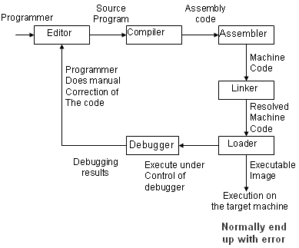
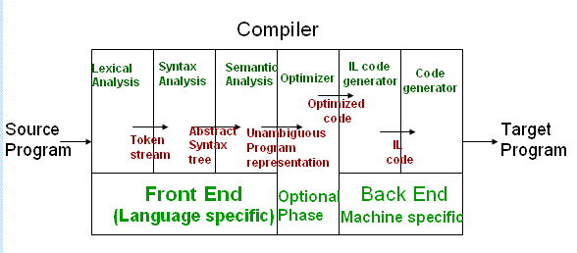
This is how the various tools work in coordination to make programming easier and better. They all
have a specific task to accomplish in the process, from writing a code to compiling it and
running/debugging it. If debugged then do manual correction in the code if needed, after getting
debugging results. It is the combined contribution of these tools that makes programming a lot
easier and efficient.
Lexical Analysis
➢ Recognizing words is not completely trivial. For

Slide 4
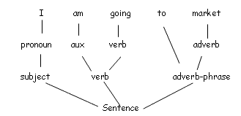
example:
ist his ase nte nce?
➢ Therefore, we must know what the word separators are
➢ The language must define rules for breaking a sentence into a sequence of words.
➢ Normally white spaces and punctuations are word separators in languages.
➢ In programming languages a character from a different class may also be treated as word
separator.
The lexical analyzer breaks a sentence into a sequence of words or tokens: - If a == b then a = 1;
else a = 2; - Sequence of words (total 14 words) if a == b then a = 1 ; else a = 2 ;
In simple words, lexical analysis is the process of identifying the words from an input string of
characters, which may be handled more easily by a parser. These words must be separated by some
predefined delimiter or there may be some rules imposed by the language for breaking the sentence
into tokens or words which are then passed on to the next phase of syntax analysis. In programming
languages, a character from a different class may also be considered as a word separator.
The next step
. Once the words are understood, the next step is to understand the structure of the sentence
. The process is known as syntax checking or parsing
Syntax analysis (also called as parsing) is a process of imposing a hierarchical (tree like) structure
on the token stream. It is basically like generating sentences for the language using language
specific grammatical rules as we have in our natural language
Ex. sentence subject + object + subject The example drawn above shows how a sentence in
English (a natural language) can be broken down into a tree form depending on the construct of
the sentence.
Parsing
Just like a natural language, a programming language also has a set of grammatical rules and hence
can be broken down into a parse tree by the parser. It is on this parse tree that the further steps of
semantic analysis are carried out. This is also used during generation of the intermediate language
code. Yacc (yet another compiler) is a program that generates parsers in the C programming
language.

Slide 5
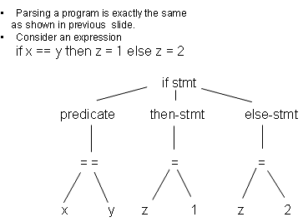
Understanding the meaning
Once the sentence structure is understood we try to understand the meaning of the sentence
(semantic analysis)
Example: Prateek said Nitin left his assignment at home
What does his refer to? Prateek or Nitin?
Even worse case
Amit said Amit left his assignment at home
How many Amits are there? Which one left the assignment?
Semantic analysis is the process of examining the statements and to make sure that they make
sense. During the semantic analysis, the types, values, and other required information about
statements are recorded, checked, and transformed appropriately to make sure the program
makes sense. Ideally there should be no ambiguity in the grammar of the language. Each sentence
should have just one meaning.
Semantic Analysis
➢ Too hard for compilers. They do not have capabilities similar to human understanding
➢ However, compilers do perform analysis to understand the meaning and catch
inconsistencies
➢ Programming languages define strict rules to avoid such ambiguities
{Int Amit = 3;
{Int Amit = 4;
cout << Amit;
}}
Since it is too hard for a compiler to do semantic analysis, the programming languages define strict
rules to avoid ambiguities and make the analysis easier. In the code written above, there is a clear
demarcation between the two instances of Amit. This has been done by putting one outside the

Slide 6
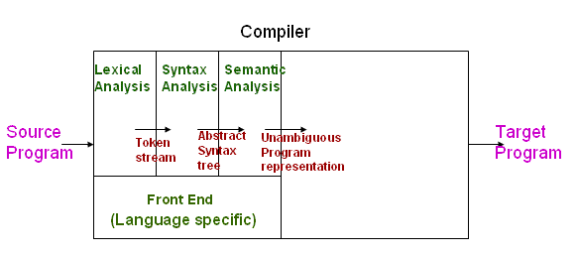
scope of other so that the compiler knows that these two Amit are different by the virtue of their
different scopes.
More on Semantic Analysis
➢ Compilers perform many other checks besides variable bindings
➢ Type checking Amit left her work at home
➢ There is a type mismatch between her and Amit . Presumably Amit is a male. And they are
not the same person.
From this we can draw an analogy with a programming statement. In the statement:
Double y = "Hello World";
the semantic analysis would reveal that "Hello World" is a string, and y is of type double,
Which is a type mismatch and hence, is wrong?
Compiler structure once again
Till now we have conceptualized the front end of the compiler with its 3 phases, viz. Lexical
Analysis, Syntax Analysis and Semantic Analysis; and the work done in each of the three phases.
Next, we look into the backend in the forthcoming slides.
Front End Phases

Slide 7
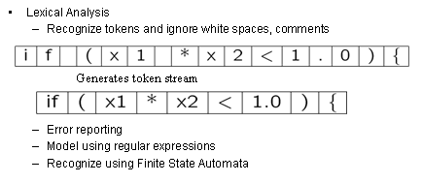
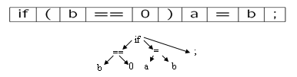
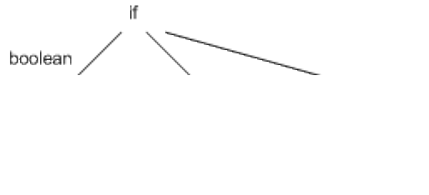
Lexical analysis is based on the finite state automata and hence finds the lexicons from the input
on the basis of corresponding regular expressions. If there is some input which it can't recognize
then it generates error. In the above example, the delimiter is a blank space. See for yourself that
the lexical analyzer recognizes identifiers, numbers, brackets etc.
Syntax Analysis
Check syntax and construct abstract syntax tree
➢ Error reporting and recovery
➢ Model using context free grammars
➢ Recognize using Push down automata/Table Driven Parsers
Syntax Analysis is modelled on the basis of context free grammars. Programming languages can be
written using context free grammars. Based on the rules of the grammar, a syntax tree can be
made from a correct code of the language. A code written in a CFG is recognized using Push Dow n
Automata. If there is any error in the syntax of the code then an error is generated by the
compiler. Some compilers also tell that what exactly is the error, if possible.
Semantic Analysis
. Check semantics
. Error reporting

Slide 8
. Disambiguate overloaded operators
.Type coercion
. Static checking
- Type checking
- Control flow checking
- Unique ness checking
- Name checks
Semantic analysis should ensure that the code is unambiguous. Also it should do the type checking
wherever needed. Ex. int y = "Hi"; should generate an error. Type coercion can be explained by the
following example:- int y = 5.6 + 1; The actual value of y used will be 6 since it is an integer. The
compiler knows that since y is an instance of an integer it cannot have the value of 6.6 so it down-
casts its value to the greatest integer less than 6.6. This is called type coercion.
Code Optimization
➢ No strong counterpart with English, but is similar to editing/précis writing
➢ Automatically modify programs so that they
➢ Run faster
➢ Use less resource (memory, registers, space, fewer fetches etc.)
➢ Some common optimizations
➢ Common sub-expression elimination
➢ Copy propagation
➢ Dead code elimination
➢ Code motion
➢ Strength reduction
➢ Constant folding
Example: x = 15 * 3 is transformed to x = 45
There is no strong counterpart in English; this is similar to precise writing where one cuts down the
redundant words. It basically cuts down the redundancy. We modify the compiled code to make it
more efficient such that it can - Run faster - Use less resources, such as memory, register, space,
fewer fetches etc
Example of Optimizations
PI = 3.14159 3A+4M+1D+2E
Area = 4 * PI * R^2
Volume = (4/3) * PI * R^3
--------------------------------

Slide 9
X = 3.14159 * R * R 3A+5M
Area = 4 * X
Volume = 1.33 * X * R
--------------------------------
Area = 4 * 3.14159 * R * R
^{2A+4M+1D} 2A+4M+1D
Volume = ( Area / 3 ) * R
--------------------------------
Area = 12.56636 * R * R 2A+3M+1D
Volume = ( Area /3 ) * R
--------------------------------
X = R * R 3A+4M
A : assignment M : multiplication
D : division E : exponent
Example: see the following code,
int x = 2;
int y = 3;
int *array[5];
for (i=0; i<5;i++)
*array[i] = x + y;
Because x and y are invariant and do not change inside of the loop, their addition doesn't need to be
performed for each loop iteration. Almost any good compiler optimizes the code. An optimizer
moves the addition of x and y outside the loop, thus creating a more efficient loop. Thus, the
optimized code in this case could look like the following:
int x = 5;
int y = 7;
int z = x + y;
int *array[10];
for (i=0; i<5;i++)
*array[i] = z;
Code Generation
➢ Usually a two step process
Generate intermediate code from the semantic representation of the program
Generate machine code from the intermediate code

Slide 10
➢ The advantage is that each phase is simple
➢ Requires design of intermediate language
➢ Most compilers perform translation between successive intermediate representations
➢ Intermediate languages are generally ordered in decreasing level of abstraction from
highest (source) to lowest (machine)
➢ However, typically the one after the intermediate code generation is the most important
The final phase of the compiler is generation of the relocatable target code. First of all,
Intermediate code is generated from the semantic representation of the source program, and this
intermediate code is used to generate machine code.
Intermediate Code Generation
➢ Abstraction at the source level identifiers, operators, expressions, statements, conditionals,
iteration, functions (user defined, system defined or libraries)
➢ Abstraction at the target level memory locations, registers, stack, opcodes, addressing
modes, system libraries, interface to the operating systems
➢ Code generation is mapping from source level abstractions to target machine abstractions
➢ Map identifiers to locations (memory/storage allocation)
➢ Explicate variable accesses (change identifier reference to reloadable/absolute address
➢ Map source operators to opcodes or a sequence of opcodes
➢ Convert conditionals and iterations to a test/jump or compare instructions
➢ Layout parameter passing protocols: locations for parameters return values, layout of
activations frame etc.
➢ Interface calls to library, runtime system, operating systems
By the very definition of an intermediate language it must be at a level of abstraction which is in the
middle of the high level source language and the low level target (machine) language. Design of the
intermediate language is important. The IL should satisfy 2 main properties:
➢ Easy to produce, and
➢ Easy to translate into target language.
Thus it must not only relate to identifiers, expressions, functions & classes but also to opcodes,
registers, etc. Then it must also map one abstraction to the other.
These are some of the things to be taken care of in the intermediate code generation
➢ Post translation Optimizations
➢ Algebraic transformations and re-ordering
➢ Remove/simplify operations like
➢ Multiplication by 1
➢ Multiplication by 0
➢ Addition with 0
- Reorder instructions based on

Slide 11
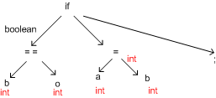
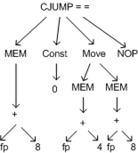
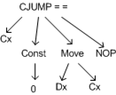
➢ Commutative properties of operators
➢ For example x+y is same as y+x (always?)
➢ Instruction selection
- Addressing mode selection
- Opcode selection
- Peephole optimization
Some of the different optimization methods are :
1) Constant Folding - replacing y= 5+7 with y=12 or y=x*0 with y=0
2) Dead Code Elimination - e.g.,
If (false)
a = 1;
else
a = 2;
with a = 2;
3) Peephole Optimization - a machine-dependent optimization that makes a pass through low-level
assembly-like instruction sequences of the program( called a peephole), and replacing them with a
faster (usually shorter) sequences by removing redundant register loads and stores if possible.
4) Flow of Control Optimizations
5) Strength Reduction - replacing more expensive expressions with cheaper ones - like pow(x,2) with
x*x
6) Common Sub expression elimination - like a = b*c, f= b*c*d with temp = b*c, a= temp, f= temp*d
Intermediate code generation

Slide 12
Code Generation
CMP Cx, 0 CMOVZ Dx,Cx
There is a clear intermediate code optimization - with 2 different sets of codes having 2 different
parse trees.The optimized code does away with the redundancy in the original code and produces
the same result.
Compiler structure
These are the various stages in the process of generation of the target code
From the source code by the compiler. These stages can be broadly classified into
. The Front End (Language specific), and
. The Back End (Machine specific) parts of compilation.
Information required about the program variables during compilation
- Class of variable: keyword, identifier etc.
- Type of variable: integer, float, array, function etc.
- Amount of storage required
- Address in the memory
- Scope information
. Location to store this information
- Attributes with the variable (has obvious problems)
- At a central repository and every phase refers to the repository whenever information is required
. Normally the second approach is preferred
- Use a data structure called symbol table
For the lexicons, additional information with its name may be needed. Information about whether it
is a keyword/identifier, its data type, value, scope, etc might be needed to be known during the
latter phases of compilation. However, all this information is not available in a straight away. This
information has to be found and stored somewhere. We store it in a data structure called Symbol
Table. Thus each phase of the compiler can access data from the symbol table & write data to it. The
method of retrieval of data is that with each lexicon a symbol table entry is associated. A pointer to
this symbol in the table can be used to retrieve more information about the lexicon

Slide 13
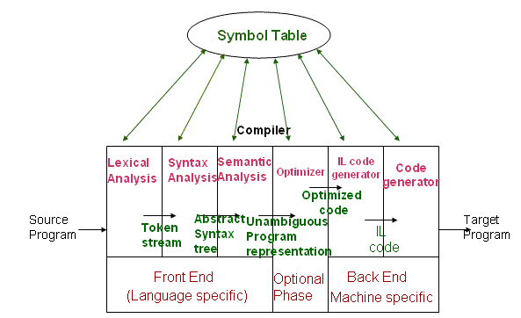
Final Compiler structure
This diagram elaborates what's written in the previous slide. You can see that each stage can access
the Symbol Table. All the relevant information about the variables, classes, functions etc. are stored
in it.
Advantages of the model
➢ . Also known as Analysis-Synthesis model of compilation
o Front end phases are known as analysis phases
o Back end phases are known as synthesis phases
➢ . Each phase has a well defined work
➢ . Each phase handles a logical activity in the process of compilation
The Analysis-Synthesis model:
The front end phases are Lexical, Syntax and Semantic analyses. These form the "analysis phase" as
you can well see these all do some kind of analysis. The Back End phases are called the "synthesis
phase" as they synthesize the intermediate and the target language and hence the program from the
representation created by the Front End phases. The advantages are that not only can lots of code
be reused, but also since the compiler is well structured - it is easy to maintain & d

Slide 14
Pass and Phase:-
Phase vs Pass in Compiler
In general, compiler is a computer program that reads a program written in one language,
which is called the source language, and translates it in to another language, which is called the
target language. Traditionally, source language was a high level language such as C++ and target
language was a low level language such as Assembly language. So, in general compilers can be seen
as translators that translate from one language to another. Pass and Phase are two terms often used
with compilers. Number of passes of a compiler is the number of times it goes over the source (or
some form of representation of it). A compiler is broken down in to parts for the convenience of
construction. Phase is often used to call such a single independent part of a compiler.
What is a Pass in a Compiler?
A standard way to classify compilers is by the number of “passes”. Usually, compiling is a relatively
resource intensive process and initially computers did not have enough memory to hold such a
program that did the complete job. Due to this limitation of hardware resources in early computers,
compilers were broken down in to smaller sub programs that did its partial job by going over the
source code (made a “pass” over the source or some other form of it) and performed analysis,
transformations and translation tasks separately. So, depending on this classification, compilers are
indentified as one-pass or multi-pass compilers.
As the name suggests, one-pass compilers compiles in a single pass. It is easier to write a one-pass
compiler and also they perform faster than multi-pass compilers. Therefore, even at the time when
you had resource limitations, languages were designed so that they could be compiled in a one-pass
(e.g. Pascal). On the other hand, a typical multi-pass compiler is made up of several main stages. The
first stage is the scanner (also known as the lexical analyzer). Scanner reads the program and
converts it to a string of tokens. The second stage is the parser. It converts the string of tokens in to
a parse tree (or an abstract syntax tree), which captures the syntactic structure of the program. Next
stage is the that interpret the semantics of the syntactic structure. The code optimizations stages
and final code generation stage follow this.
What is a Phase in a Compiler?
The term phase often comes up when you talk about compiler construction. Initially, compilers were
every simple pieces of single, monolithic software written by one person for the compilation of a
simple language. But when the source code of the language to be translated becomes complex and
large, the compiler was broken down in to multiple (relatively independent) phases. The advantage
of having different phases is that the development of the compiler can be distributed among a team
of developers. Furthermore, it improves the modularity and reuse by allowing phases to be replaced
by improved ones or additional phases (such as further optimizations) to be added to the compiler.
The process of dividing the compilation to phases was introduced by the PQCC (Production Quality
Compiler-Compiler Project) at Carnegie Melon University. They introduced the terms front end,

Slide 15
middle end and back end. Most compilers have at least two phases. But usually, back end and front
end encapsulate these phases.
What is the difference between Phase and Pass in Compiler?
Phase and Pass are two terms used in the area of compilers. A pass is a single time the compiler
passes over (goes through) the sources code or some other representation of it. Typically, most
compilers have at least two phases called front end and back end, while they could be either one-
pass or multi-pass. Phase is used to classify compilers according to the construction, while pass is
used to classify compilers according to how they operate.
A compiler can have many phases and passes.
➢ Pass: A pass refers to the traversal of a compiler through the entire program.
➢ Phase: A phase of a compiler is a distinguishable stage, which takes input from the previous stage, processes and yields output that can be used as input for the next stage. A pass can have more than one phase..
Bootstrapping:-
Compiler is a complex program and should not be written in assembly language
➢ How to write compiler for a language in the same language (first time!)?
➢ First time this experiment was done for Lisp
➢ Initially, Lisp was used as a notation for writing functions.
➢ Functions were then hand translated into assembly language and executed
➢ McCarthy wrote a function eval [e,a] in Lisp that took a Lisp expression e as an argument
➢ The function was later hand translated and it became an interpreter for Lisp
Writing a compiler in assembly language directly can be a very tedious task. It is generally written in some high level language. What if the compiler is written in its intended source language itself? This was done for the first time for Lisp. Initially, Lisp was used as a notation for writing functions. Functions were then hand translated into assembly language and executed. McCarthy wrote a function eval [ e , a ] in Lisp that took a Lisp expression e as an argument. Then it analyzed the expression and translated it into the assembly code. The function was later hand translated and it became an interpreter for Lisp.
Bootstrapping.
➢ A compiler can be characterized by three languages: the source language (S), the target
language (T), and the implementation language (I)
➢ The three languages S, I, and T can be quite different. Such a compiler is called cross-
compiler

Slide 16
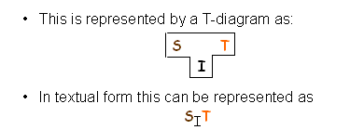
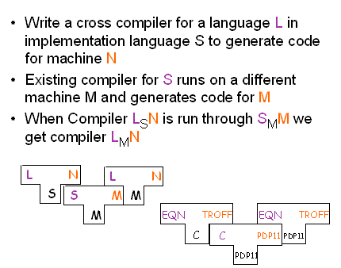
Compilers are of two kinds: native and cross.
Native compilers are written in the same language as the target language. For example, SMM is a
compiler for the language S that is in a language that runs on machine M and generates output code
that runs on machine M.
Cross compilers are written in different language as the target language. For example, SNM is a
compiler for the language S that is in a language that runs on machine N and generates output code
that runs on machine M.
Bootstrapping.
The compiler of LSN is written in language S. This compiler code is compiled once on SMM to
generate the compiler's code in a language that runs on machine M. So, in effect, we get a compiler
that converts code in language L to code that runs on machine N and the compiler itself is in
language M. In other words, we get LMN.
Bootstrapping a Compiler

Slide 17
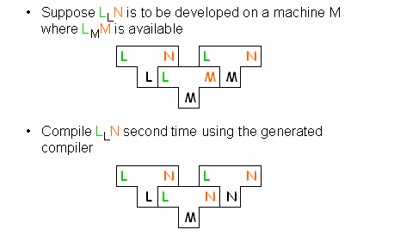
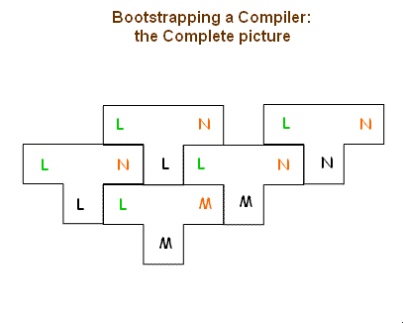
Using the technique described in the last slide, we try to use a compiler for a language L written in L.
For this we require a compiler of L that runs on machine M and outputs code for machine M. First
we write LLN i.e. we have a compiler written in L that converts code written in L to code that can run
on machine N. We then compile this compiler program written in L on the available compiler LMM.
So, we get a compiler program that can run on machine M and convert code written in L to code that
can run on machine N i.e. we get LMN. Now, we again compile the original written compiler LLN on
this new compiler LMN we got in last step. This compilation will convert the compiler code written in
L to code that can run on machine N. So, we finally have a compiler code that can run on machine N
and converts code in language L to code that will run on machine N. i.e. we get LNN.
Bootstrapping is obtaining a compiler for a language L by writing the compiler code in the same
language L. We have discussed the steps involved in the last three slides. This slide shows the
complete diagrammatical representation of the process.

Slide 18
Compiler Construction Tools:- The following are the construction tools:-
➢ Generate lexical analyzers
➢ Syntax analyzers,
➢ Semantic analyzers,
➢ Intermediate code,
➢ Optimized target code
Lexical Analyzer:-
• scanner generators
• input: source program
• output: lexical analyzer
• task of reading characters from source program and recognizing tokens or basic
syntactic components
• Maintains a list of reserved words Flex (fast lexical analyzer generator)
• Example which specifies a scanner which replaces the string “username” with the
user’s login name
Syntax Analyzer:-
• Parser generators
• input: context-free grammar
• output: syntax analyzer
• The task of the syntax analyzer is to produce a representation of the source program in a
form directly representing its syntax structure. This representation is usually in the form of a
binary tree or similar data structure.
• Bison (Yacc-compatible parser gen.) [5]
• a general purpose parser generator that converts grammar description for an LALR(1) CFG
into a C program
• Bison grammar example (reverse polish notation)
%{
#define YYSTYPE double
#include <math.h>
%}
Semantic Analyzer:-
• syntax-directed translators
• input: parse tree
• output: routines to generate I-code
• “The role of the semantic analyzer is to derive methods by which the structures constructed
by the syntax analyzer may be evaluate or executed.“
• type checker
• two common tactics:
o ~ flatten the semantic analyzer’s parse tree

Slide 19
o ~ embed semantic analyzer w/in syntax analyzer
o (syntax-driven translation)
Intermediate Code Generator:-
• Automatic code generators
• input: I-code rules
• output: crude target machine program
• “The task of the code generator is to traverse this tree, producing functionally equivalent
object code.”
• three address code is one type
Code Optimizer:-
• Data flow engines
• input: I-code
• output: transformed code
• “This improvement is achieved by program transformations that are traditionally called
optimizations, although the term ‘optimization’ is a misnomer because there is rarely a
guarantee that the resulting code is the best possible.”
• Machine or assembly code is used along with knowledge of target machine’s instruction set
to replace I-code instructions with shorter or more quickly executed instructions - this is
repeated as much as is necessary.
Code Generator:-
• Automatic code generators
• input: optimized (transformed) I-code
• output: target machine program
Applications of compiler technology:-
➢ Many applications for compiler technology
➢ Parsers for HTML in web browser
➢ Interpreters for javascript/flash
➢ Machine code generation for high level languages
➢ Software testing
➢ Program optimization
➢ Malicious code detection
➢ Design of new computer architectures
➢ Compiler-in-the-loop hardware development
➢ Hardware synthesis: VHDL to RTL translation
➢ Compiled simulation

Slide 20
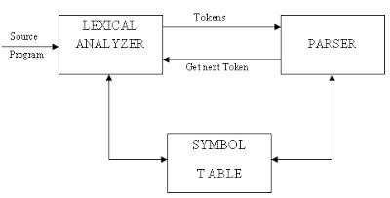
➢ Used to simulate designs written in VHDL
➢ Text-formatting languages.
➢ Silicon compiler for the creation of VLSI circuits
➢ Command languages of OS.
➢ Query languages of Database systems.
A compiler is possibly the most complex system software and writing it is a substantial exercise in
software engineering The complexity arises from the fact that it is required to map a programmer’s
requirements (in a HLL program) to architectural details It uses algorithms and techniques from a
very large number of areas in computer science Translates intricate theory into practice - enables
tool building.
Role of lexical Analyzer:-
Why to separate Lexical analysis and parsing?
1. Simplicity of design
2. Improving compiler efficiency
3. Enhancing compiler portability
The main task is to read the input characters and produce as output sequence of tokens that the
parser uses for syntax analysis.
Fig Role of the lexical analyzer diagram
Up on receiving a “get next token” command from the parser, the lexical analyzer reads input
characters until it can identify the next token.
Its secondary tasks are,
• One task is stripping out from the source program comments and white space is in the form
of blank, tab, new line characters.
• Another task is correlating error messages from the compiler with the source program.
Sometimes lexical analyzer is divided in to cascade of two phases.
1) Scanning 2) lexical analysis.

Slide 21
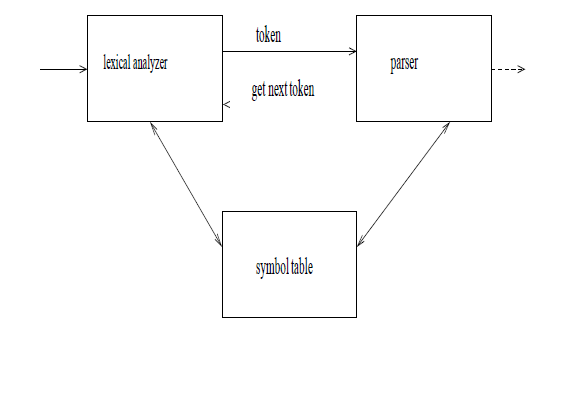
The scanner is responsible for doing simple tasks, while the lexical analyzer proper does the more
complex operations.
➢ Lexical analysis : process of taking an input string of characters (such as the
source code of a computer program) and producing a sequence of symbols called
➢ Lexical tokens, or just tokens, which may be handled more easily by a parser.
➢ The lexical analyzer reads the source text and, thus, it may perform certain
Secondary tasks:
➢ Eliminate comments and white spaces in the form of blanks, tab and
➢ newline characters.
➢ Correlate errors messages from the compiler with the source program (eg,
➢ keep track of the number of lines), ...
➢ The interaction with the parser is usually done by making the lexical analyzer be a sub-
routine of the parser.
Input buffering:-
 Sometimes lexical analyzer needs to look ahead some symbols to decide about the token to
return
 In C language: we need to look after -, = or < to decide what token to return
 In Fortran: DO 5 I = 1.25
 We need to introduce a two buffer scheme to handle large look-aheads safely
Switch (*forward++) {
case eof:
if (forward is at end of first buffer) {
reload second buffer;
forward = beginning of second buffer;
}
else if {forward is at end of second buffer) {
reload first buffer;\
forward = beginning of first buffer;
}
else /* eof within a buffer marks the end of input */
terminate lexical analysis;

Slide 22
break;
cases for the other characters;
Specification of tokens:-
 In theory of compilation regular expressions are used to formalize the specification of tokens
 Regular expressions are means for specifying regular languages
 Example:
 Letter_(letter_ | digit)*
 Each regular expression is a pattern specifying the form of strings
Regular expressions are notation for specifying patterns.
• Each pattern matches a set of strings.
Regular expressions will serve as names for sets of strings.
• Strings and Languages:
• The term alphabet or character class denotes any finite set of symbols.
• e.g., set {0,1} is the binary alphabet.
• The term sentence and word are often used as synonyms for the term string.
• The length of a string s is written as |s| - is the number of occurrences of symbols in s.
• e.g., string “banana” is of length six.
• The empty string denoted by ε – length of empty string is zero.
• The term language denotes any set of strings over some fixed alphabet.
• e.g., {ε} – set containing only empty string is language under φ.
• If x and y are strings, then the concatenation of x and y (written as xy) is the string formed by appending y to x. x = dog and y = house; then xy is doghouse.
• sε = εs = s.
• s⁰ = ε, s¹ = s, s² = ss, s³ = sss, … so on.
Table1.2 Terms for parts of a string
TERM DEFINITION
Prefix of s A string obtained by removing zero or more trailing symbols of string s;
e.g., ban is a prefix of banana.
Suffix of s A string formed by deleting zero or more of the leading symbols of s; e.g., nana is a suffix of banana.
Substring of s A string obtained by deleting a prefix and a suffix from s; e.g., nan is a substring of banana.
Proper prefix, suffix, Any nonempty string x that is a prefix, suffix or substring of s that s <> x. or substring of s
Subsequence of s Any string formed by deleting zero or more not necessarily contiguous symbols from s; e.g., baaa is a subsequence of banana.
• Operations on Languages:
– There are several operations that can be applied to languages:
Table 1.3 Definitions of operations on languages L and M OPERATION DEFINITION
Union of L and M. written LυM L υ M = { s | s is in L or s is in M }
Concatenation of L and M. LM = { st | s is in L and t is in M }
written LM

Slide 23
Kleene closure of L. written L*
L* denotes “zero or more concatenation of” L.
Positive closure of L. written L+
L⁺ denotes “one or more Concatenation of” L.
• Regular Expressions:
– It allows defining the sets to form tokens precisely.
– e.g., letter ( letter | digit) *
– Defines a Pascal identifier – which says that the identifier is formed by a letter followed by zero or more letters or digits.
– A regular expression is built up out of simpler regular expressions using a set of defining rules.
– Each regular expression r denotes a language L(r).
• The rules that define the regular expressions over alphabet ∑.
– (Associated with each rule is a specification of the language denoted by the regular expression being defined)
• 1. ε is a regular expression that denotes {ε}, i.e. the set containing the empty string.
• 2. If a is a symbol in ∑, then a is a regular expression that denotes {a}, i.e. the set containing the string a.
• 3. Suppose r and s are regular expressions denoting the languages L(r) and L(s). Then
– a) (r) | (s) is a regular expression denoting the languages L(r) U L(s).
– b) (r)(s) is a regular expression denoting the languages L(r)L(s).
– c) (r)* is a regular expression denoting the languages (L(r))*.
– d) (r) is a regular expression denoting the languages L(r).
• A language denoted by a regular expression is said to be a regular set.
• The specification of a regular expression is an example of a recursive definition.
• Rule (1) and (2) form the basis of the definition.
• Rule (3) provides the inductive step.
Table 1.4 Algebraic Properties of regular expressions
AXIOM DESCRIPTION
r|s = s|r | is commutative r|(s|t) = (r|s)|t | is associative
(rs)t = r(st) Concatenation is associative r(s|t) = rs|rt Concatenation distributes over | (s|t)r = sr|tr
εr = r ε is the identity element for concatenation rε = r
r* = (r|ε)* Relation between * and ε
r** = r* * Is idempotent
• Regular Definition:

Slide 24
– If ∑ is an alphabet of basic symbols, then a regular definition is a sequence of definitions of the
form
• d₁ → r₁
• d2 → r2
• …
• d_{n} → r_{n}
– Where each di is a distinct name, and each ri is a regular expression over the symbols in ∑ U {d1, d2,
… , di-1}, i.e., the basic symbols and the previously defined names.
– e.g. (regular definition in bold):
• letter → A|B|…|Z|a|b|…|z
• digit → 0|1|…|9
• id → letter (letter | digit ) *
• Notational Shorthand:
– This shorthand is used in certain constructs that occur frequently in regular expressions.
• 1. one or more instance: unary postfix operator ⁺ means “one or more instances of”. If r is a
regular expression that denotes the language L(r), the r⁺ is a regular expression that denotes the
language (L(r))⁺. Similarly unary postfix operator * means “zero or more instances of”. The two
algebraic identities r* and r⁺ relate the kleene and positive closure operators.
• 2. zero or one instance: unary postfix operator? means “zero or one instance of”. The notation r?
is shorthand for r|ε.
• 3. Character class: the notation [abc] is a shorthand for a|b|c.
Specification of tokens
Regular expressions are notation for specifying patterns.
• Each pattern matches a set of strings.
Regular expressions will serve as names for sets of strings.
• Strings and Languages:
• The term alphabet or character class denotes any finite set of symbols.
• e.g., set {0,1} is the binary alphabet.
• The term sentence and word are often used as synonyms for the term string.
• The length of a string s is written as |s| - is the number of occurrences of symbols in s.
• e.g., string “banana” is of length six.
• The empty string denoted by ε – length of empty string is zero.
• The term language denotes any set of strings over some fixed alphabet.
• e.g., {ε} – set containing only empty string is language under φ.
• If x and y are strings, then the concatenation of x and y (written as xy) is the string formed by
appending y to x. x = dog and y = house; then xy is doghouse.
• sε = εs = s.
• s⁰ = ε, s¹ = s, s² = ss, s³ = sss, … so on.
Table1.2 Terms for parts of a string
TERM DEFINITION
Prefix of s A string obtained by removing zero or more trailing symbols of string s;
e.g., ban is a prefix of banana.
Suffix of s A string formed by deleting zero or more of the leading symbols of s; e.g.,

Slide 25
nana is a suffix of banana.
Substring of s A string obtained by deleting a prefix and a suffix from s; e.g., nan is a
substring of banana.
Proper prefix, suffix, Any nonempty string x that is a prefix, suffix or substring of s that s <> x.
or substring of s
Subsequence of s Any string formed by deleting zero or more not necessarily contiguous
symbols from s; e.g., baaa is a subsequence of banana.
• Operations on Languages:
– There are several operations that can be applied to languages:
Definitions of operations on languages L and M
OPERATION DEFINITION
Union of L and M. written LυM L υ M = { s | s is in L or s is in M }
Concatenation of L and M. LM = { st | s is in L and t is in M }
written LM
Kleene closure of L.
written L*
L* denotes “zero or more concatenation of” L.
Positive closure of L.
written L+
L⁺ denotes “one or more Concatenation of” L.
• Regular Expressions:
– It allows defining the sets to form tokens precisely.
– e.g., letter ( letter | digit) *
– Defines a Pascal identifier – which says that the identifier is formed by a letter followed by zero or
more letters or digits.
– A regular expression is built up out of simpler regular expressions using a set of defining rules.
– Each regular expression r denotes a language L(r).
• The rules that define the regular expressions over alphabet ∑.
– (Associated with each rule is a specification of the language denoted by the regular expression
being defined)
• 1. ε is a regular expression that denotes {ε}, i.e. the set containing the empty string.
• 2. If a is a symbol in ∑, then a is a regular expression that denotes {a}, i.e. the set containing the
string a.
• 3. Suppose r and s are regular expressions denoting the languages L(r) and L(s). Then
– a) (r) | (s) is a regular expression denoting the languages L(r) U L(s).
– b) (r)(s) is a regular expression denoting the languages L(r)L(s).
– c) (r)* is a regular expression denoting the languages (L(r))*.
– d) (r) is a regular expression denoting the languages L(r).
• A language denoted by a regular expression is said to be a regular set.

Slide 26
• The specification of a regular expression is an example of a recursive definition.
• Rule (1) and (2) form the basis of the definition.
• Rule (3) provides the inductive step.
Algebraic Properties of regular expressions
AXIOM DESCRIPTION
r|s = s|r | is commutative
r|(s|t) = (r|s)|t | is associative
(rs)t = r(st) Concatenation is associative
r(s|t) = rs|rt Concatenation distributes over |
(s|t)r = sr|tr
εr = r ε is the identity element for concatenation
rε = r
r* = (r|ε)* Relation between * and ε
r** = r* * Is idempotent
• Regular Definition:
– If ∑ is an alphabet of basic symbols, then a regular definition is a sequence of definitions of the
form
• d₁ → r₁
• d₂ → r₂
• …
• d_{n} → r_{n}
– Where each d_{i} is a distinct name, and each r_{i} is a regular expression over the symbols in ∑ U {d₁, d₂,
… , d_{i-1}}, i.e., the basic symbols and the previously defined names.
– e.g. (regular definition in bold):
• letter → A|B|…|Z|a|b|…|z
• digit → 0|1|…|9
• id → letter (letter | digit ) *
• Notational Shorthand:
– This shorthand is used in certain constructs that occur frequently in regular expressions.
• 1. one or more instance: unary postfix operator ⁺ means “one or more instances of”. If r is a regular expression that denotes the language L(r), the r⁺ is a regular expression that denotes the language (L(r))⁺. Similarly unary postfix operator * means “zero or more instances of”. The two algebraic identities r* and r⁺ relate the kleene and positive closure operators.
• 2. zero or one instance: unary postfix operator? means “zero or one instance of”. The notation r?
is shorthand for r|ε.
• 3. Character class: the notation [abc] is a shorthand for a|b|c.

Slide 27
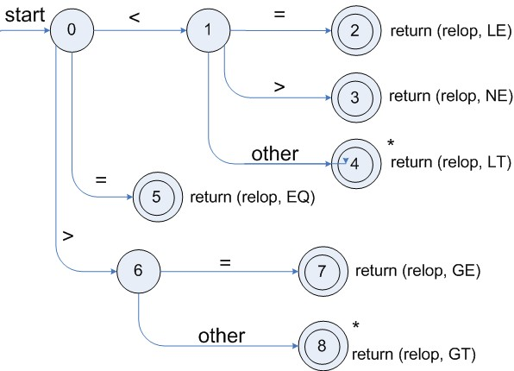
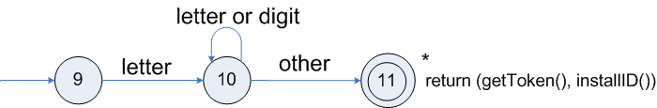
Recognition of tokens:-
 Starting point is the language grammar to understand the tokens:
stmt -> if expr then stmt
| if expr then stmt else stmt
| Ɛ
expr -> term relop term | term
term -> id | number
 The next step is to formalize the patterns:
digit -> [0-9]
Digits -> digit+
number -> digit(.digits)? (E[+-]? Digit)?
letter -> [A-Za-z_]
id -> letter (letter|digit)*
If -> if
Then -> then
Else -> else
Relop -> < | > | <= | >= | = | <>
 We also need to handle whitespaces:
ws -> (blank | tab | newline)+
Transition diagram for relop
Transition diagram for reserved words and identifiers

Slide 28
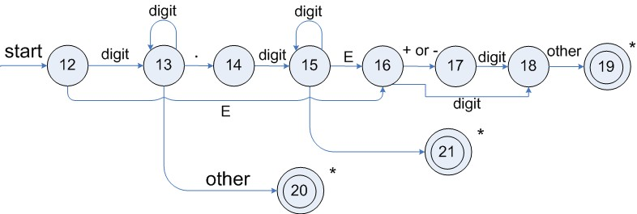
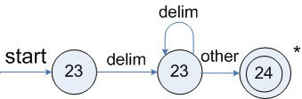
Transition diagram for unsigned numbers
Transition diagram for whitespace
Architecture of a transition-diagram-based lexical analyzer
TOKEN getRelop()
{
TOKEN retToken = new (RELOP)
while (1) { /* repeat character processing until a
return or failure occurs */
switch(state) {
case 0: c= nextchar();
if (c == ‘<‘) state = 1;
else if (c == ‘=‘) state = 5;
else if (c == ‘>’) state = 6;
else fail(); /* lexeme is not a relop */
break;
case 1: …
…
case 8: retract();
retToken.attribute = GT;
return(retToken);
}

Slide 29
Lexical Analyzer Generator – Lex:-
1. Program to count the number of vowels and consonants in a given string.
%{
#include<stdio.h>
int vowels=0;
int cons=0;
%}
%%
[aeiouAEIOU] {vowels++;}
[a-zA-Z] {cons++;}
%%
int yywrap()
{
return 1;
}
main ()
{
printf (“Enter the string.. at end press ^d\n”);
yylex ();
printf (“No of vowels=%d\nNo of consonants=%d\n”, vowels, cons);
}
Lex source is a table of regular expressions and corresponding program fragments. The table is
translated to a program which reads an input stream, copying it to an output stream and partitioning
the input into strings which match the given expressions. As each such string is recognized the
corresponding program fragment is executed. The recognition of the expressions is performed by a
deterministic finite automaton generated by Lex. The program fragments written by the user are
executed in the order in which the corresponding regular expressions occur in the input stream.
Three sections of lex programs:-
➢ Declaration Section
➢ Rule Section
➢ Procedural Section
Declarations Section
This section contains entries that:
• Include standard I/O header file.
• Define global variables.
• Define the list rule as the place to start processing.
• Define the tokens used by the parser.
• Define the operators and their precedence.
Rules Section

Slide 30
The rules section defines the rules that parse the input stream.
Programs Section
The programs section contains the following subroutines. Because these subroutines are included in
this file, you do not need to use the yacc library when processing this file.
main The required main program that calls the yyparse subroutine to start the program.
yyerror(s) This error-handling subroutine only prints a syntax error message.
yywrap The wrap-up subroutine that returns a value of 1 when the end of input occurs.
The general format of Lex source is:
{definitions}
%%
{rules}
%%
{user subroutines}
where the definitions and the user subroutines are often omitted. The second %% is optional, but
the first is required to mark the beginning of the rules. The absolute minimum Lex program is thus
%%
(no definitions, no rules) which translates into a program which copies the input to the output
unchanged.
In the outline of Lex programs shown above, the rules represent the user's control decisions; they
are a table, in which the left column contains regular expressions (see section 3) and the right
column contains actions, program fragments to be executed when the expressions are recognized.
Thus an individual rule might appear
integer printf("found keyword INT");
to look for the string integer in the input stream and print the message ``found keyword INT''
whenever it appears. In this example the host procedural language is C and the C library function
printf is used to print the string. The end of the expression is indicated by the first blank or tab
character. If the action is merely a single C expression, it can just be given on the right side of the
line; if it is compound, or takes more than a line, it should be enclosed in braces. As a slightly more
useful example, suppose it is desired to change a number of words from British to American spelling.
Lex rules such as
colour printf("color");
mechanise printf("mechanize");
petrol printf("gas");
would be a start. These rules are not quite enough, since the word petroleum would become
gaseum; a way of dealing with this will be described later.
What is meant by Lex?
Lex is a program designed to generate scanners, also known as tokenizers, which recognize lexical
patterns in text. Lex is an acronym that stands for "lexical analyzer generator."
Lex includes this file and utilizes the definitions for token values. To obtain tokens yacc calls yylex.
Function yylex has a return type of int that returns a token. Values associated with the token are
returned by lex in variable yylval.

Slide 31
Running a Lex and Yacc program
For compiling a lex program
1. Write the lex program in a file and save it as file.l (where file is the name of the file).
2. Open the terminal and navigate to the directory where you have saved the file.l
3. type - lex file.l
4. then type - cc lex.yy.c -ll
5. then type - ./a.out
Your lex progam will be running now (provided it is correct). for compiling lex and yacc together
1. write lex program in a file file.l and yacc in a file file.y
2. open the terminal and navigate to the directory where you have saved the files.
3. type lex file.l
4. type yacc file.y
5. type cc lex.yy.c y.tab.h -ll
6. type ./a.out

