Slide 1
UNIT V
STATES, STATE GRAPHS, AND TRANSITION TESTING
STATE GRAPHS
5.1 States:
A combination of circumstances or attributes belonging
for the time being to a person or thing

Slide 2
A program that detects the character sequence ―ZCZC can be in the following states:
1. Neither ZCZC nor any part of it has been detected.
2. Z has been detected.
3. ZC has been detected.
4. ZCZ has been detected.
5. ZCZC has been detected

Slide 3
A moving automobile whose engine is running can have the following states with respect to its transmission:
1. Reverse gear
2. Neutral gear
3. First gear
4. Second gear
5. Third gear
6. Fourth gear

Slide 4
A person‘s cheque book can have the following states with respect to the bank balance:
1. Equal
2. Less than
3. Greater than
A word processing program menu can be in the following states with respect to file manipulation:
1. Copy document
2. Delete document
3. Rename document
4. Create document
5. Compress document
6. Copy disc
7. Format disc
8. Backup disc
9. Recover from backup

Slide 5
States are represented by nodes.
States are numbered or may be identified by or whatever else is convenient.
A state graph and its associated state table are useful models for describing software (program) behavior
A state graph is a graphical representation of the program (its FSM) in terms of states, transitions, inputs and outputs (erroneous or normal).

Slide 7
5.2 Inputs and Transitions:
Whatever is being modeled is subjected to inputs. As a result of those inputs, the state changes, or is said to have made a transition. Transitions are denoted by links that join the states. The input that causes the transition are marked on the link; that is, the inputs are link weights.
There is one outlink from every state for every input.

Slide 8
A finite-state machine is an abstract device that can be represented by a state graph having a finite number of states and a finite number of transitions between states.
The ZCZC detection example can have the following kinds of inputs:
1. Z
2. C
3. Any character other than Z or C, which we‘ll denote by A

Slide 9
5.3Outputs
An output can be associated with any link. Outputs are denoted by letters or words and are separated from inputs by a slash as follows: ―input/output.

Slide 10
GOOD STATE GRAPHS AND BAD
The total number of states is equal to the product of the possibilities of factors that make up the state.
2. For every state and input there is exactly one transition specified to exactly one, possibly the same state.

Slide 11
3. For every transition there is one output action specified. That output could be trivial, but at least one output does something sensible.
4. For every state there is a sequence of inputs that will drive the system back to the same state.

Slide 12
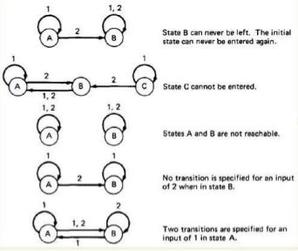

Slide 13
State Bugs
i)Number of States
The number of states in a state graph is the number of states we choose to recognize or model
1. Identify all the component factors of the state.
2. Identify all the allowable values for each factor.
3. The number of states is the product of the number of allowable values of all the factors.

Slide 14
ii) Impossible States
Some combinations of factors may appear to be impossible. Say that the factors are:
GEAR R, N, 1, 2, 3, 4 = 6 factors
DIRECTION Forward, reverse, stopped = 3 factors
ENGINE Running, stopped = 2 factors
TRANSMISSION Okay, broken = 2 factors
ENGINE Okay, broken = 2 factors
TOTAL = 144 states

Slide 15
But broken engines can‘t run, so the combination of factors for engine condition and engine operation yields only 3
rather than 4 states. Therefore, the total number of states is at most 108
iii) Equivalent States
Two states are equivalent if every sequence of inputs starting from one state produces exactly the same sequence of outputs when started from the other state

Slide 16
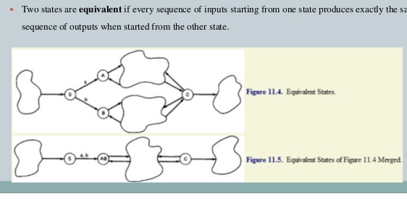

Slide 17
Transition Bugs
Unspecified and Contradictory Transitions
1.Every input-state combination must have a specified transition. If the transition is impossible, then there must be a
mechanism that prevents that input from occurring in that state—look for it
2.Exactly one transition
must be specified for every combination of input and state

