Slide 1
G PULLAIAH COLLEGE OF ENGINEERING AND TECHNOLOGY
DEPARTMENT OF Civil Engineering
Subject:
COST EFFECTIVE HOUSING TECHNIQUES

Slide 2
Unit-I
INTRODUCTION TO HOUSING
Definition of Basic Terms – House, Home, Household, Apartments, Multi storied Buildings, Special Buildings, Objectives and Strategies of National Housing Policies including Slum Housing Policy, Principle of Sustainable Housing – Integrated approach on arriving holding capacity and density norms - All basic infrastructure consideration - Institutions for Housing at National, State and Local levels.

Slide 3
Definition of House
A house is a building that functions as a home, ranging from simple dwellings such as rudimentary huts of nomadic tribes and the improvised shacks in shanty towns to complex, fixed structures of wood, brick, concrete or other materials containing plumbing, ventilation and electrical systems.
Most conventional modern houses in Western cultures will contain one or more bedrooms and bathrooms, a kitchen or cooking area, and a living room. A house may have a separate dining room, or the eating area may be integrated into another room.

Slide 4
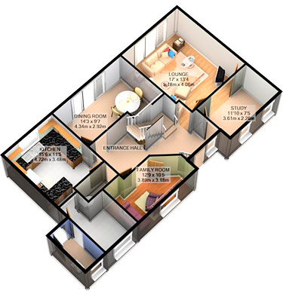

Slide 5
1 Agricultural buildings 2 Residential buildings 3 Educational buildings 4 Government buildings 5 Industrial buildings
Types of structural buildings

Slide 6
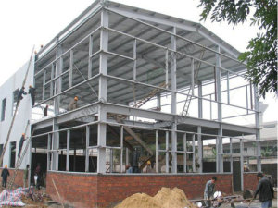
Barn : - A barn is an agricultural building primarily located on farms and used for many purposes, notably for the housing of livestock and storage of crops
Agricultural buildings

Slide 7
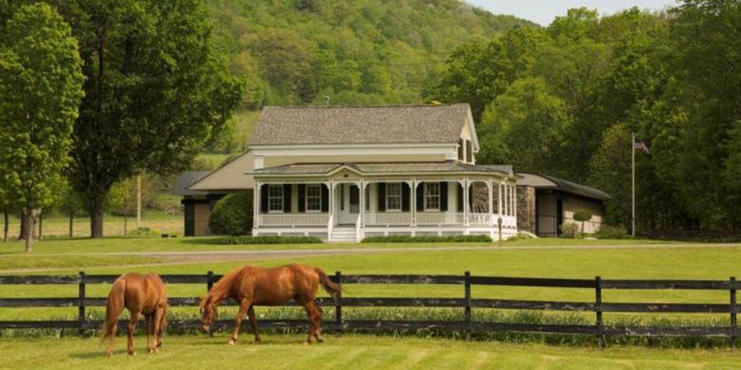
Farmhouse is a general term for the main house of a farm. It is a type of building or house which serves a residential purpose in a rural or agricultural setting. Historically common were farmhouses which were combined with space for animals called a house barn.
Farmhouse

Slide 8
1 Apartment block 2 Condominium 3 Dormitory 4 Duplex building
Residential buildings

Slide 9
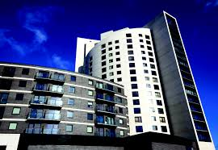
It is defined a high-rise as “A multi-story structure between 35-100 meters tall, or a building of unknown height from 12-39 floors.
Apartment block

Slide 10
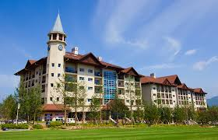
A condominium is the form of housing tenure and other real property where a specified part of a piece of a real is individual owned.
Condominium

Slide 11
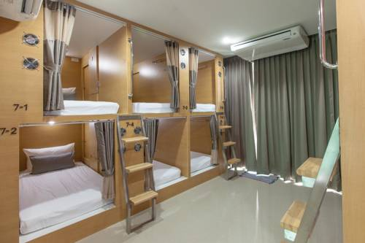
A dormitory in the United States is a residence hall consisting of sleeping quarters or entire buildings primarily providing sleeping and residential quarters for large numbers of people.
Dormitory

Slide 12
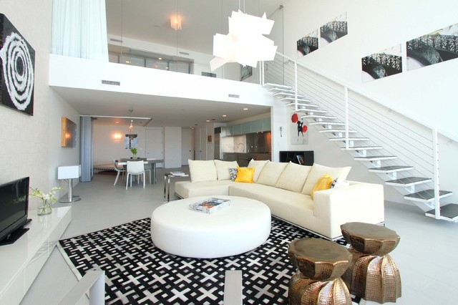
A duplex house is a dwelling having apartments with separate entrances for two households. This includes two-story houses having a complete apartment on each floor and also side-by-side apartments on a single lot that share a common wall.
Duplex building

Slide 13
Educational buildings Government buildings Industrial buildings Parking and storage
And another houses are

Slide 14
In this policy the planning commission was formed to know the requirement of house , types of people, no of village house required and no of houses in urban area are collected and decisions are made. This commission forms 5 sub commissions among them. - Housing development - Finance of the works - Deals with rural housing - Welfare schemes and - The problems of housing requirement.
NATIONAL HOUSING POLICY (NHP)

Slide 15
India has an area of 328.73 million hectares; the population of India exceeds 100 crs. In this, 75% of the people still living in villages. According to the statics 4 lakh, 87,170 villages are present. Keeping in view of the above points the government provides 5 year plan. 8th five year plan are formed based on the basic criteria of improvement of villages. The 8th five year plan combines any local agencies to achieve the objectives in this plan. In this, NHP is proposed.

Slide 16
- Urban Planning Encouraging State Governments, Urban Local Bodies, Development Authorities to periodically update their Master Plans and Zoning Plans which should, interlaid adequately provide for housing and basic services for the urban poor. - Increase flow of Funds Promoting larger flow of funds from governmental and private sources for fulfilling housing and infrastructure needs by designing innovative financial instruments.
The National Urban Housing and Habitat Policy aims

Slide 17
“A sustainable house is one that uses energy and material more effectively both in production and operation while polluting and damaging natural systems as little as possible.” The common objective is that green buildings are designed to reduce the overall impact of the built environment on human health and the natural environment by: - Efficiently using energy, water, and other resources - Protecting occupant health and improving employee productivity - Reducing waste, pollution and environmental degradation
SUSTAINABLE HOUSE

Slide 18
State any two principles of sustainable housing. (Apr./May 2005, May/June 2006) The important features or principles of sustainable housing is as follows. - The needs of the housing are to be satisfied or fulfilled for the present requirement without affecting the environment. - Sustainable development should ensure the environmental protection while taking the housing programs. - The sustainable development should ensure the maximum rate of resource consumption. - The waste materials should not be harmful to the society.
Principles of sustainable Housing

Slide 19
The following are the organization acting at state level for housing program - AP Housing Board [TNHB] - AP Slim Clearance Board [TNSCB] - AP Police Housing Corporation [TNPHC] - Co-operaTive housing societies - Land development bank - Building Centre [Located at collectorate of each districts] - Private housing finance
STATE LEVEL ORGANISATION FOR HOUSING

Slide 20
Objectives
1. To clear all the slums in Chemical and to provide self contained hygienic
tenements.
2. To prevent the growth of slams and encroachments
3. To prevent the eviction of slum dwellers by private owners and to provide the
slum families with security of tenure.
4. To provide basic amenities like water supply, street lights, storm water drains, sewer
line, etc to the slum areas.

Slide 21
1. Housing Urban Development Corporation (HUDCO): The was started in the year 1970. In the middle of 1971 it was functioning. The primary aim of (HUDCO) is Housing, development, improvement and urban development. It acts as an apex body [forum] to decide the fund, investment required for satisfying the primary aim. HUDCO introduced new schemes for development of the investment. 2. Housing Development Finance Corporation [HDFC]: This was started in the year 1976 and run by financial assists of the government HDFC develops housing schemes from the fund collected through the public. It generates the fund by equity shares, insurance premium, and bank loan as per the approval of reserve bank.
Central Government Organization for Housing

Slide 22
3. Life Insurance Corporation [LIC] LIC provides financial assistance for housing. LIC started a housing finance in the name “LIC House Finance Limited” in the year 1989. These functions with 67 branches and 35% of market share. 4. National Housing and Habitat Policy [NHHP] In the year 1998, on the eve of the 12th Lok Sabha elections, the BJP and its Alliance partners brought out a ‘National Agenda for Governance’ for ushering in a dynamic economic growth to bring in quality life for mases. This agenda included issues like Governance, Eradication of Unemployment, Housing for All etc.

Slide 23
1. Permission 2. Space of buildings 3. DimensioNS 4. Ventilation of buildings ns of rooms 5. Minimum width 6. Chimneys 7. Staircase Documents to be submitted for approval of building in municipality : The person who intends or wants to construct, reconstruct or alter or making additional construction in the existing building have to applied for approval of the buildings. - Plan - Survey filed number, street ward, taluk and district. - Signature of applicant and license building surveyor - Copy of land document - Estimate of building construction.
MUNICIPALITY BYELAWS AND BUILDING RULES

Slide 24
Documents to be submitted for approval of plan : - Plan (Floor Wise) - Elevation (Front) - Sectional View (Floor Wise) - Site Plan - Key Plan Details to be furnished in plan : - Jointary details (Doors, Windows, ventilation, Opening) - Area details (Site area, Floor area, Plinth area) - Boundary lines in different colors.

