Slide 1
STORY WRITING

Slide 2
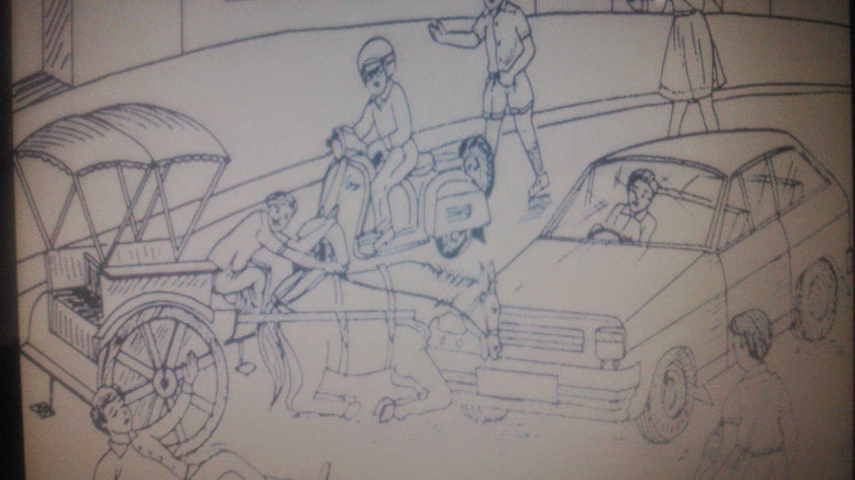
Story on a Tonga Accident scene.

Slide 3
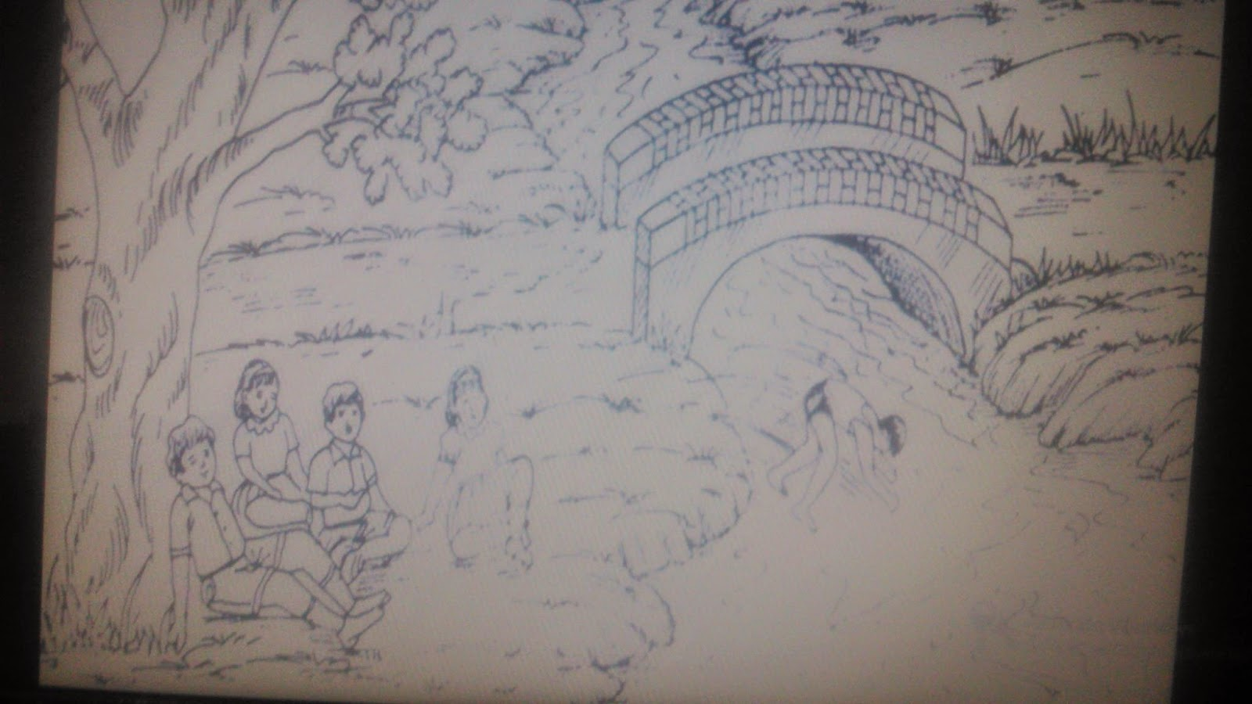
River bank Scene

Slide 4
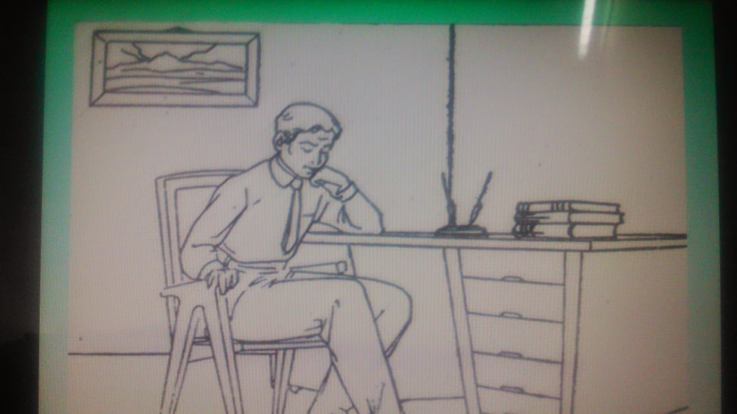
A person sitting on chair.

Slide 5
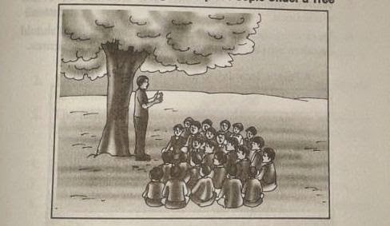
A Person Addressing a Group of People Under a Tree

Slide 6
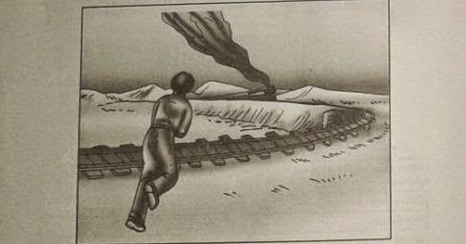
A person running in the direction of a train

Slide 7
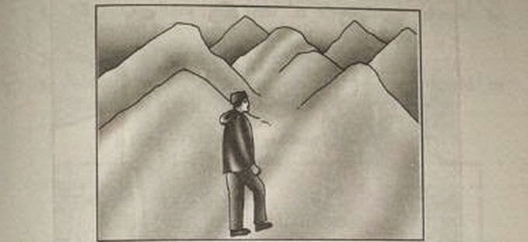
A PERSON STANDING AT BASE OF MOUNTAIN

