Slide 1
UNIT-II
Relations and Their Properties

Slide 2
Relations
Binary relations represent relationships between the elements of two sets.
A binary relation R from set A to set B is defined by: R ⊆ A × B
If (a,b) ∈ R, we write:
aRb (a is related to b by R)
If (a,b) ∉ R, we write:
aRb (a is not related to b by R)

Slide 3
Relations
A relation is represented by a set of ordered pairs
If A = {a, b} and B = {1, 2, 3}, then a relation R₁ from A to B might be, for example, R₁ = {(a, 2), (a, 3), (b, 2)}.
The first element in each ordered pair comes from set A, and the second element in each ordered pair comes from set B.

Slide 4
Example
Example:
A = {0,1,2}
B = {a,b}
A × B = {(0,a), (0,b), (1,a), (1,b), (2,a), (2,b)}
Then R = {(0,a), (0,b), (1,a), (2,b)} is a relation from A to B.
Can we write 0Ra ? yes
Can we write 2Rb ? yes
Can we write 1Rb ? no

Slide 5
Example
A relation may be represented graphically or as a table:
R | a | b
0 | X | X
1 | X
2 |  | X
0
1
2
a
b
We can see that 0Ra but 1Rb.
/

Slide 6
Functions as Relations
A function is a relation that has the restriction that each element of A can be related to exactly one element of B.
Relation
Function
1
a
1
a
b
b

Slide 7
Relations on a Set
Relations can also be from a set to itself.
A relation on the set A is a relation from set A to set A, i.e., R ⊆ A × A
Let A = {1, 2, 3, 4}
Which ordered pairs are in the relation R = {(a,b) | a divides b}?
R = {(1,1), (1,2), (1,3), (1,4), (2,2), (2,4), (3,3), (4,4)}

Slide 8
Relations on a Set
Which of these relations (on the set of integers) contain each of the pairs (1,1), (1,2), (2,1), (1,-1), and (2,2)?
R₁ = {(a,b) | a ≤ b}
R₂ = {(a,b) | a > b}
R₃ = {(a,b) | a = b, a = −b}
R₄ = {(a,b) | a = b}
R₅ = {(a,b) | a = b + 1}
R₆ = {(a,b) | a + b ≤ 3}
Notes:
(1,1) is in R1, R3, R4, and R6. (1,2) is in R1 and R6. (2,1) is in R2, R5, and R6. (-1,1) is in R2, R3, and R6. (2,2) is in R1, R3, and R4.

Slide 9
Relations on a Set
The pair (1,1) is in R₁, R₃, R₄ and R₆
The pair (1,2) is in R₁ and R₆
The pair (2,1) is in R₂ , R₅ and R₆
The pair (1,-1) is in R₂ , R₃ and R₆
The pair (2,2) is in R₁ , R₃ and R₄
Notes:
(1,1) is in R1, R3, R4, and R6. (1,2) is in R1 and R6. (2,1) is in R2, R5, and R6. (-1,1) is in R2, R3, and R6. (2,2) is in R1, R3, and R4.

Slide 10
Relations on a Set
How many relations are there on a set with n elements?
A relation on a set A is a subset of A × A.
If A has n elements, how many elements are there in A × A?
n²
We know that a set with m elements has 2^{m} subsets, so how many subsets are there of A × A?
Notes:
(1,1) is in R1, R3, R4, and R6. (1,2) is in R1 and R6. (2,1) is in R2, R5, and R6. (-1,1) is in R2, R3, and R6. (2,2) is in R1, R3, and R4.

Slide 11
Relations on a Set
There are relations on a set with n elements.
How many relations are there on set S = {a, b, c}?
There are 3 elements in set S, so S × S has 3² = 9 elements.
Therefore, there are 2⁹ = 512 different relations on the set S = {a, b, c}.
Notes:
(1,1) is in R1, R3, R4, and R6. (1,2) is in R1 and R6. (2,1) is in R2, R5, and R6. (-1,1) is in R2, R3, and R6. (2,2) is in R1, R3, and R4.

Slide 12
Properties of Relations
Let R be a relation on set A.
R is reflexive if:
(a, a) ∈ R for every element a ∈ A.

Slide 13
Example
Determine the properties of the following relations on {1, 2, 3, 4}
R₁ = {(1,1), (1,2), (2,1), (2,2), (3,4), (4,1), (4,4)}
R₂ = {(1,1), (1,2), (2,1)}
R₃ = {(1,1), (1,2), (1,4), (2,1), (2,2), (3,3), (4,1), (4,4)}
R₄ = {(2,1), (3,1), (3,2), (4,1), (4,2), (4,3)}
R₅ = {(1,1), (1,2), (1,3), (1,4), (2,2), (2,3), (2,4), (3,3), (3,4), (4,4)}
R₆ = {(3,4)}
Which of these is reflexive?

Slide 14
Example
Which of these is reflexive?
R₁ = {(1,1), (1,2), (2,1), (2,2), (3,4), (4,1), (4,4)}
R₂ = {(1,1), (1,2), (2,1)}
R₃ = {(1,1), (1,2), (1,4), (2,1), (2,2), (3,3), (4,1), (4,4)}
R₄ = {(2,1), (3,1), (3,2), (4,1), (4,2), (4,3)}
R₅ = {(1,1), (1,2), (1,3), (1,4), (2,2), (2,3), (2,4), (3,3), (3,4), (4,4)}
R₆ = {(3,4)}
The relations R₃ and R₅ are reflexive because they contain all pairs of the form (a,a); the other don’t [they are all missing (3,3)].

Slide 15
Properties of Relations
Let R be a relation on set A.
R is symmetric if:
(b, a) ∈ R whenever (a, b) ∈ R, where a, b ∈ A.
A relation is symmetric iff “a is related to b” implies that “b is related to a”.

Slide 16
Example
Which of these is symmetric?
R₁ = {(1,1), (1,2), (2,1), (2,2), (3,4), (4,1), (4,4)}
R₂ = {(1,1), (1,2), (2,1)}
R₃ = {(1,1), (1,2), (1,4), (2,1), (2,2), (3,3), (4,1), (4,4)}
R₄ = {(2,1), (3,1), (3,2), (4,1), (4,2), (4,3)}
R₅ = {(1,1), (1,2), (1,3), (1,4), (2,2), (2,3), (2,4), (3,3), (3,4), (4,4)}
R₆ = {(3,4)}
The relations R₂ and R₃ are symmetric because in each case (b,a) belongs to the relation whenever (a,b) does.
The other relations aren’t symmetric.

Slide 17
Properties of Relations
Let R be a relation on set A.
R is antisymmetric if whenever (a, b) ∈ R and (b, a) ∈ R, then a = b, where a, b ∈ A.
A relation is antisymmetric iff there are no pairs of distinct elements with a related to b and b related to a. That is, the only way to have a related to b and b related to a is for a and b to be the same element.
Symmetric and antisymmetric are NOT exactly opposites.

Slide 18
Example
Which of these is antisymmetric?
R₁ = {(1,1), (1,2), (2,1), (2,2), (3,4), (4,1), (4,4)}
R₂ = {(1,1), (1,2), (2,1)}
R₃ = {(1,1), (1,2), (1,4), (2,1), (2,2), (3,3), (4,1), (4,4)}
R₄ = {(2,1), (3,1), (3,2), (4,1), (4,2), (4,3)}
R₅ = {(1,1), (1,2), (1,3), (1,4), (2,2), (2,3), (2,4), (3,3), (3,4), (4,4)}
R₆ = {(3,4)}
The relations R₄, R₅ are antisymmetric because there is no pair of elements a and b with a ≠ b such that both (a,b) and (b,a) belong to the relation.
The other relations aren’t antisymmetric.

Slide 19
Properties of Relations
Let R be a relation on set A.
R is transitive if whenever (a ,b) ∈ R and (b, c) ∈ R, then (a, c) ∈ R, where a, b, c ∈ A.

Slide 20
Example
Which of these is transitive?
R₁ = {(1,1), (1,2), (2,1), (2,2), (3,4), (4,1), (4,4)}
R₂ = {(1,1), (1,2), (2,1)}
R₃ = {(1,1), (1,2), (1,4), (2,1), (2,2), (3,3), (4,1), (4,4)}
R₄ = { (2,1), (3,1), (3,2), (4,1), (4,2) , (4,3)}
R₅ = {(1,1), (1,2), (1,3), (1,4), (2,2), (2,3), (2,4), (3,3), (3,4), (4,4)}
R₆ = {(3,4)}
The relations R₄, R₅ are transitive because if (a,b) and (b,c) belong to the relation, then (a,c) does also.
The other relations aren’t transitive.

Slide 21
Combining Relations
Relations from A to B are subsets of A × B.
For example, if A = {1, 2} and B= {a, b}, then
A × B = {(1, a), (1, b), (2, a), (2, b)}
Two relations from A to B can be combined in any way that two sets can be combined. Specifically, we can find the union, intersection, exclusive-or, and difference of the two relations.

Slide 22
Combining Relations
Let A = {1, 2, 3} and B= {1, 2, 3, 4}, and suppose we have the relations:
R₁ = {(1,1), (2,2), (3,3)} , and
R₂ = {(1,1), (1,2), (1,3), (1,4)}.
Then we can find the union, intersection, and difference of the relations:
R₁ ∪ R₂ = {(1,1), (1,2), (1,3), (1,4), (2,2), (3,3)}
R₁ ∩ R₂ = {(1,1)}
R₁ - R₂ = {(2,2), (3,3)}
R₂ - R₁ = {(1,2), (1,3), (1,4)}

Slide 23
Composition of Relations
If R₁ is a relation from A to B and R₂ is a relation from B to C, then the composition of R₁ with R₂ (denoted R₂□R₁) is the relation from A to C.
If (a, b) is a member of R₁ and (b, c) is a member of R₂, then (a, c) is a member of R₂ □ R₁, where a ∈ A, b ∈ B, c ∈ C.

Slide 24
Example
Let
A={a,b,c}, B={w,x,y,z}, C={A,B,C,D}
R₁={(a,z),(b,w)}, R₂={(w,B),(w,D),(x,A)}
Find R₂ □ R₁
Match (b,c) with (a,b) to get (a,c)
R₂’s b’s are w and x; R₁’s b’s are z and w
Only the w’s match; R₁ has only 1 w pair, (b,w)
So the (a, c) pairs will include b from R₁ and B and D from R₂: (b, B), (b, D)

Slide 25
Example
Given the following relations, find S □ R :
R = {(1,1), (1,4), (2,3), (3,1), (3,4)}
S = {(1,0),(2,0), (3,1), (3,2), (4,1)}
Construct the ordered pairs in S □ R as follows:
for each ordered pair in R
for each ordered pair in S
if (r₁ , r₂) (s₁ , s₂) are the same
then (r₁, s₂) belongs to S □ R

Slide 26
Example
Given the following relations, find S □ R :
R = {(1,1), (1,4), (2,3), (3,1), (3,4)}
S = {(1,0),(2,0), (3,1), (3,2), (4,1)}
Construct the ordered pairs in S □ R :
S □ R = {(1,0), (1,1), (2,1), (2,2), (3,0), (3,1)}

Slide 27
The Powers of a Relation
The powers of a relation R are recursively defined from the definition of a composite of two relations.
Let R be a relation on the set A. The powers R^{n}, for n = 1, 2, 3, … are defined recursively by:
R¹ = R
R^{n+1} = R^{n} □ R :
So:
R² = R □ R
R³ = R² □ R = (R □ R) □ R)
etc.

Slide 28
The Powers of a Relation
Let R = {(1,1), (2,1), (3,2), (4,3)}
Find the powers R^{n} , where n = 1, 2, 3, 4, …
R¹ = R = {(1,1), (2,1), (3,2), (4,3)}
R² = R □ R = {(1,1), (2,1), (3,1), (4,2)}
R³ = R² □ R = {(1,1), (2,1), (3,1), (4,1)}
R⁴ = R³ □ R = {(1,1), (2,1), (3,1), (4,1)}
R⁵ = R⁴ □ R = {(1,1), (2,1), (3,1), (4,1)}

Slide 29
The Powers of a Relation
The relation R on a set A is transitive iff R^{n} ⊆ R for n = 1, 2, 3, 4, …

Slide 30
Representing Relations

Slide 31
Representing Relations Using Matrices
Let R be a relation from A to B
A = {a₁, a₂, … , a_{m}}
B = {b₁, b₂, … , b_{n}}
The zero-one matrix representing the relation R has a 1 as its (i, j) entry when a_{i} is related to b_{j} and a 0 in this position if a_{i} is not related to b_{j}.

Slide 32
Example
Let R be a relation from A to B
A={a, b, c}
B={d, e}
R={(a, d), (b, e), (c, d)}
Find the relation matrix for R

Slide 33
Relation Matrix
Let R be a relation from A to B
A={a, b, c}
B={d, e}
R={(a, d), (b, e), (c, d)}
Note that A is represented by the rows and B by the columns in the matrix.
Cell_{ij} in the matrix contains a 1 iff a_{i} is related to b_{j}.

Slide 34
Relation Matrices and Properties
Let R be a binary relation on a set A and let M be the zero-one matrix for R.
R is reflexive iff M_{ii} = 1 for all i
R is symmetric iff M is a symmetric matrix, i.e., M = M^{T}
R is antisymmetric if M_{i j}= 0 or M_{ji} = 0 for all i ≠ j

Slide 35
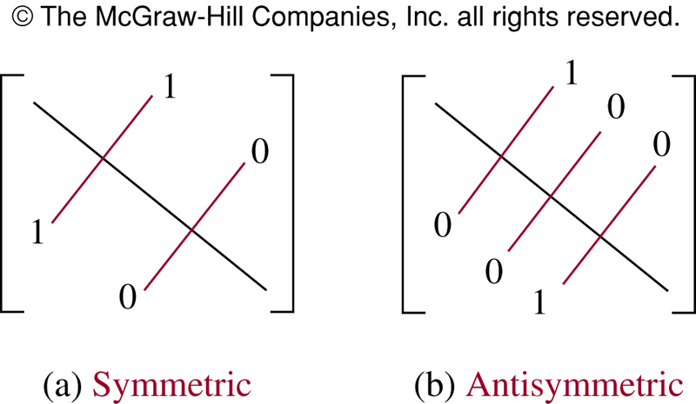
Relation Matrices and Properties

Slide 36
Example
Suppose that the relation R on a set is represented by the matrix M_{R}.
⎡
1
1
0
⎤
⎢
⎥
M
=
1
1
1
R
⎢
⎥
⎢
0
1
1
⎥
⎣
⎦
Is R reflexive, symmetric, and / or antisymmetric?

Slide 37
Example
⎡
1
1
0
⎤
Is R reflexive?
Is R symmetric?
Is R antisymmetric?
⎢
⎥
M
=
1
1
1
R
⎢
⎥
⎢
0
1
1
⎥
⎣
⎦
All the diagonal elements = 1, so R is reflexive.
The lower left triangle of the matrix = the upper right triangle, so R is symmetric.
To be antisymmetric, it must be the case that no more than one element in a symmetric position on either side of the diagonal = 1. But M₂₃ = M₃₂ = 1. So R is not antisymmetric.

Slide 38
Representing Relations Using Digraphs
Represent:
each element of the set by a point
each ordered pair using an arc with its direction indicated by an arrow

Slide 39
Representing Relations Using Digraphs
A directed graph (or digraph) consists of a set V of vertices (or nodes) together with a set E of ordered pairs of elements of V called edges (or arcs).
The vertex a is called the initial vertex of the edge (a, b).
The vertex b is called the terminal vertex of the edge (a, b).

Slide 40
Example
Let R be a relation on set A
A={a, b, c}
R={(a, b), (a, c), (b, b), (c, a), (c, b)}.
Draw the digraph that represents R
a
b
c

Slide 41
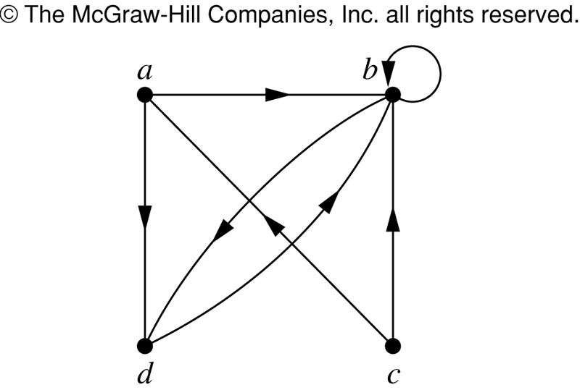
Representing Relations Using Digraphs
This is a digraph with:
V = {a, b, c}
E = {(a, b), (a, d), (b, b),
(b, d), (c, a), (c, b), (d, b)}
Note that edge (b, b) is represented using an arc from vertex b back to itself. This kind of an edge is called a loop.

Slide 42
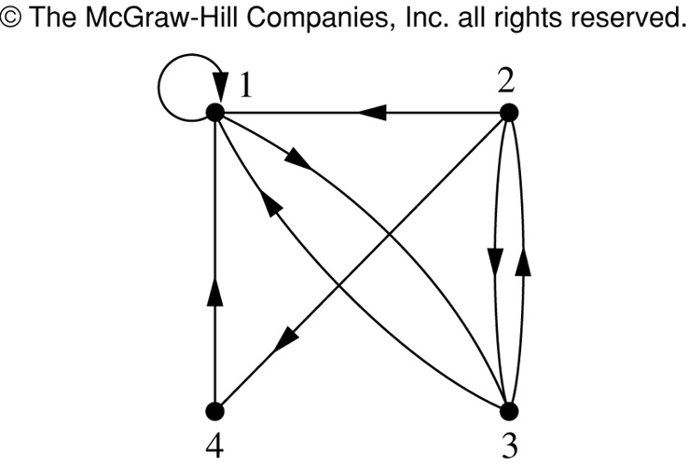
Example
What are the ordered pairs in the relation R represented by the directed graph to the left?
This digraph represents the relation
R = {(1,1), (1,3), (2,1), (2,3), (2,4), (3,1), (3,2), (4,1)}
on the set {1, 2, 3, 4}.

Slide 43
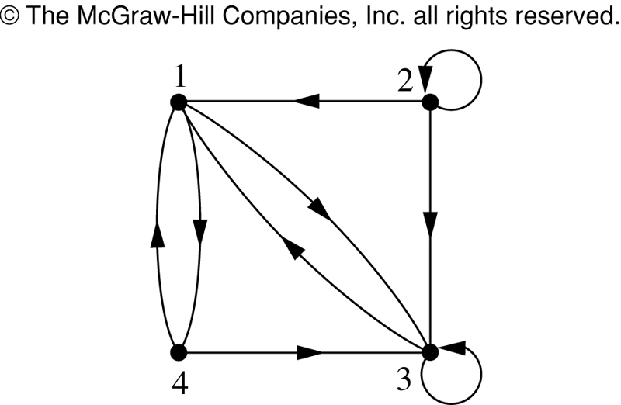
Example
What are the ordered pairs in the relation R represented by the directed graph to the left?
R = {(1,3), (1,4), (2,1), (2,2), (2,3), (3,1), (3,3), (4,1), (4,3)}

Slide 44
Example
According to the digraph representing R:
is (4,3) an ordered pair in R?
is (3,4) an ordered pair in R?
is (3,3) an ordered pair in R?
(4,3) is an ordered pair in R
(3,4) is not an ordered pair in R – no arrowhead pointing from 3 to 4
(3,3) is an ordered pair in R – loop back to itself

Slide 45
Relation Digraphs and Properties
A relation digraph can be used to determine whether the relation has various properties
Reflexive - must be a loop at every vertex.
Symmetric - for every edge between two distinct points there must be an edge in the opposite direction.
Antisymmetric - There are never two edges in opposite direction between two distinct points.
Transitive - If there is an edge from x to y and an edge from y to z, there must be an edge from x to z.

Slide 46
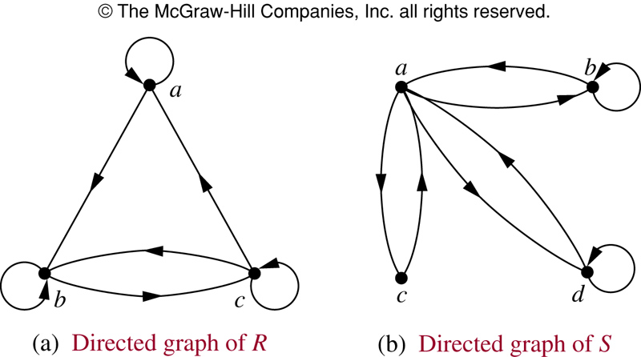
Example
According to the digraph representing R:
is R reflexive?
is R symmetric?
is R antisymmetric?
is R transitive?
R is reflexive – there is a loop at every vertex
R is not symmetric – there is an edge from a to b but not from b to a
R is not antisymmetric – there are edges in both directions connecting b and c
R is not transitive – there is an edge from a to b and an edge from b to c, but not from a to c

Slide 47
Example
According to the digraph representing S:
is S reflexive?
is S symmetric?
is S antisymmetric?
is S transitive?
S is not reflexive – there aren’t loops at every vertex
S is symmetric – for every edge from one distinct vertex to another, there is a matching edge in the opposite direction
S is not antisymmetric – there are edges in both directions connecting a and b
S is not transitive – there is an edge from c to a and an edge from a to b, but not from c to b

Slide 48
Homework Exercise
Label the relations below as reflexive (or not), symmetric (or not), antisymmetric (or not), and transitive (or not).
A B C D
Notes:
A: not reflexive, symmetric, antisymmetric, transitive
B: not reflexive, not symmetric, not antisymmetric, not transitive
C: not reflexive, not symmetric, antisymmetric, not transitive
D: not reflexive, not symmetric, antisymmetric, transitive

Slide 49
Equivalence Relations

Slide 50
Equivalence Relations
A relation on set A is called an equivalence relation if it is:
reflexive,
symmetric, and
transitive

Slide 51
Equivalence Relations
Two elements a and b that are related by an equivalence relation are said to be equivalent.
We use the notation
a ∼ b
to denote that a and b are equivalent elements with repect to a particular equivalence relation.

Slide 52
Example
Let R be a relation on set A, where A = {1, 2, 3, 4, 5} and R = {(1,1), (2,2), (3,3), (4,4), (5,5), (1,3), (3,1)}
Is R an equivalence relation?
We can solve this by drawing a relation digraph:
Reflexive – there must be a loop at every vertex.
Symmetric - for every edge between two distinct points there must be an edge in the opposite direction.
Transitive - if there is an edge from x to y and an edge from y to z, there must be an edge from x to z.

Slide 53
Example
1
2
3
4
5
Is R an equivalence relation? yes

Slide 54
Example – Congruence modulo m
Let R = {(a, b) | a ≡ b (mod m)} be a relation on the set of integers and m be a positive integer > 1.
Is R an equivalence relation?
Reflexive – is it true that a ≡ a (mod m)}? yes
Symmetric – is it true that if a ≡ b (mod m) then b ≡ a (mod m)? yes
Transitive - is it true that if a ≡ b (mod m) and b ≡ c (mod m) then a ≡ c (mod m)? yes

Slide 55
Example
Suppose that R is the relation on the set of strings of English letters such that aRb iff l(a) = l(b), where l(x) is the length of the string x.
Is R an equivalence relation?

Slide 56
Example
Since l(a) = l(a), then aRa for any string a. So R is reflexive.
Suppose aRb, so that l(a) = l(b). Then it is also true that l(b) = l(a), which means that bRa. Consequently, R is symmetric.
Suppose aRb and bRc. Then l(a) = l(b) and l(b) = l(c). Therefore, l(a) = l(c) and so aRc. Hence, R is transitive.
Therefore, R is an equivalence relation.

Slide 57
Equivalence Class
Let R be a equivalence relation on set A.
The set of all elements that are related to an element a of A is called the equivalence class of a.
The equivalence class of a with respect to R is:
[a]_{R} = {s | (s, a) ∈ R}
When only one relation is under consideration, we will just write [a].

Slide 58
Equivalence Class
If R is a equivalence relation on a set A, the equivalence class of the element a is:
[a]_{R} = {s | (s, a) ∈ R}
If b ∈ [a]_{R} , then b is called a representative of this equivalence class.

Slide 59
Equivalence Class
Let R be the relation on the set of integers such that aRb iff a = b or a = -b. We can show that this is an equivalence relation.
The equivalence class of element a is
[a] = {a, -a}
Examples:
[7] = {7, -7} [-5] = {5, -5}
[0] = {0}

Slide 60
Equivalence Example
Consider the equivalence relation R on set A. What are the equivalence classes?
A = {1, 2, 3, 4, 5}
R = {(1,1), (2,2), (3,3), (4,4), (5,5), (1,3), (3,1)}
Just look at the aRb relationships. Which elements are related to which?
[1] = {1, 3} [2] = {2}
[3] = {3, 1} [4] = {4}
[5] = {5}

Slide 61
A useful theorem about classes
Let R be an equivalence relation on a set A. These statements for a and b of A are equivalent:
aRb
[a] = [b]
[a] ∩ [b] ≠ ∅

Slide 62
A useful theorem about classes
More importantly:
Equivalence classes are EITHER
equal or
disjoint

Slide 63
Partitions
A partition of a set A divides A into non-overlapping subsets:
A partition of a set A is a collection of disjoint nonempty subsets of A that have A as their union.
Example 1
A₂
A₁
A₆
A₃
A₅
A₄
Set A

Slide 64
Partitions
A partition of a set A divides A into non-overlapping subsets:
Let S be a given set and A={A1,A2,….Am} where each Ai,i-1,2… is a subset of S
Set A is called covering of S and setsA1,A2,… are said to cover S
A partition of a set A is a collection of disjoint nonempty subsets of A that have A as their union. Then the subsets are called blocks of the partition.
Example 2
S = {a, b, c, d, e, f }
S₁ = {a, d, e}
S₂ = {b}
S₃ = {c, f }
P = {S₁, S₂, S₃}
P is a partition of set S

Slide 65
Partitions and Equivalence Relations
Let R be an equivalence relation on set S
then the equivalence classes of R form a partition of S
Conversely, if {A_{i} | i ∈ I } is a partition of set S,
then there is an equivalence relation R that has the sets A_{i} (i ∈ I) as its equivalence classes

Slide 66
Example
If S = {1, 2, 3, 4, 5, 6}, then
A₁ = {1, 3, 4}
A₂ = {2, 5}
A₃ = {6}
form a partition of S, because:
these sets are disjoint
the union of these sets is S.

Slide 67
Example
If S = {1, 2, 3, 4, 5, 6}, then
A₁ = {1, 3, 4, 5}
A₂ = {2, 5}
A₃ = {6}
do not form a partition of S, because:
these sets are not disjoint (5 occurs in two different sets)

Slide 68
Example
If S = {1, 2, 3, 4, 5, 6}, then
A₁ = {1, 3}
A₂ = {2, 5}
A₃ = {6}
do not form a partition of S, because:
the union of these sets is not S (since 4 is not a member of any of the subsets, but is a member of S).

Slide 69
Example
If S = {1, 2, 3, 4, 5, 6}, then
A₁ = {1, 3, 4}
A₂ = {2, 5}
A₃ = {6, 7}
do not form a partition of S, because:
the union of these sets is not S (since 7 is a member of set A₃ but is not a member of S).

Slide 70
Constructing an Equivalence Relation from a Partition
Given set S = {1, 2, 3, 4, 5, 6} and a partition of S,
A₁ = {1, 2, 3}
A₂ = {4, 5}
A₃ = {6}
then we can find the ordered pairs that make up the equivalence relation R produced by that partition.

Slide 71
Constructing an Equivalence Relation from a Partition
The subsets in the partition of S,
A₁ = {1, 2, 3}
A₂ = {4, 5}
A₃ = {6}
are the equivalence classes of R. This means that the pair (a,b) ∈ R iff a and b are in the same subset of the partition.

Slide 72
Constructing an Equivalence Relation from a Partition
Let’s find the ordered pairs that are in R:
A₁ = {1, 2, 3} → (1,1), (1,2), (1,3), (2,1),
(2,2), (2,3), (3,1), (3,2), (3,3)
A₂ = {4, 5} → (4,4), (4,5), (5,4), (5,5)
A₃ = {6} → (6,6)
So R is just the set consisting of all these ordered pairs:
R = {(1,1), (1,2), (1,3), (2,1), (2,2), (2,3), (3,1), (3,2), (3,3), (4,4), (4,5), (5,4), (5,5), (6,6)}

Slide 73
Partial Orderings

Slide 74
Introduction
A relation R on a set S is called a partial ordering or partial order if it is:
reflexive
antisymmetric
transitive
A set S together with a partial ordering R is called a partially ordered set, or poset, and is denoted by (S, R).

Slide 75
Example
Let R be a relation on set A. Is R a partial order?
A = {1, 2, 3, 4}
R = {(1,1), (1,2), (1,3), (1,4), (2,2),
(2,3), (2,4), (3,3), (3,4), (4,4)}

Slide 76
Example
Is R a partial order?
R = {(1,1), (1,2), (1,3), (1,4), (2,2), (2,3), (2,4), (3,3), (3,4), (4,4)}
To be a partial order, R must be reflexive, antisymmetric, and transitive.
R is reflexive because R includes (1,1), (2,2), (3,3) and (4,4).
R is antisymmetric because for every pair (a,b) in R, (b,a) is not in R (unless a = b).
R is transitive because for every pair (a,b) in R, if (b,c) is in R then (a,c) is also in R.

Slide 77
Example
So, given
A = {1, 2, 3, 4}
R = {(1,1), (1,2), (1,3), (1,4), (2,2),
(2,3), (2,4), (3,3), (3,4), (4,4)}
R is a partial order, and
(A, R) is a poset.

Slide 78
Example
Is the “≥” relation a partial ordering on the set of integers?
Since a ≥ a for every integer a, ≥ is reflexive
If a ≥ b and b ≥ a, then a = b. Hence ≥ is anti-symmetric.
Since a ≥ b and b ≥ c implies a ≥ c, ≥ is transitive.
Therefore “≥” is a partial ordering on the set of integers and (Z, ≥) is a poset.

Slide 79
Comparable / Incomparable
In a poset the notation a ≼ b denotes (a, b) ∈ R
The “less than or equal to” (≤)is just an example of partial ordering
The elements a and b of a poset (S, ≼) are called comparable if either a≼b or b≼a.
The elements a and b of a poset (S, ≼) are called incomparable if neither a≼b nor b≼a.
In the poset (Z⁺, |):
Are 3 and 9 comparable? Yes; 3 divides 9
Are 5 and 7 comparable? No; neither divides the other

Slide 80
Total Order
We said: “Partial ordering” because pairs of elements may be incomparable.
If every two elements of a poset (S, ≼) are comparable, then S is called a totally ordered or linearly ordered set and ≼ is called a total order or linear order.
A totally ordered set is also called a chain.

Slide 81
Total Order
The poset (Z, ≤) is totally ordered. Why?
Every two elements of Z are comparable; that is, a ≤ b or b ≤ a for all integers.
The poset (Z⁺, |) is not totally ordered. Why?
It contains elements that are incomarable; for example 5 | 7.
/

